Slide 1

Introduction to Graph Theory

Slide 2
Graph Theory
Computer science loves to borrow stuff. More specifically, it has borrowed a lot of concepts from logic and mathematics.
As it turns out, this is the case with graphs.
Graph data structures as we know them to be computer science actually came from math, and the study of graphs, which is referred to as graph theory.

Slide 3
Graph Theory
In mathematics, graphs are a way to formally represent a network, which is basically just a collection of objects that are all interconnected.

Slide 4
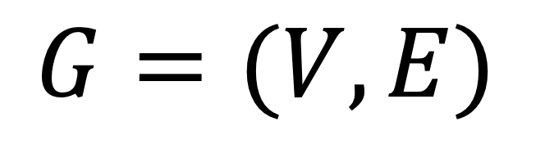
Formal Definition of a Graph
A graph (G) is a pair of vertices (V) and a set of edges (E),
$$G=(V,E)$$
Formal mathematical notation for defining graphs!

Slide 5
Components of a Graph
There are two main parts of a graph:
The vertices or nodes where the data is stored
The edges or connections which connect the nodes

Slide 6
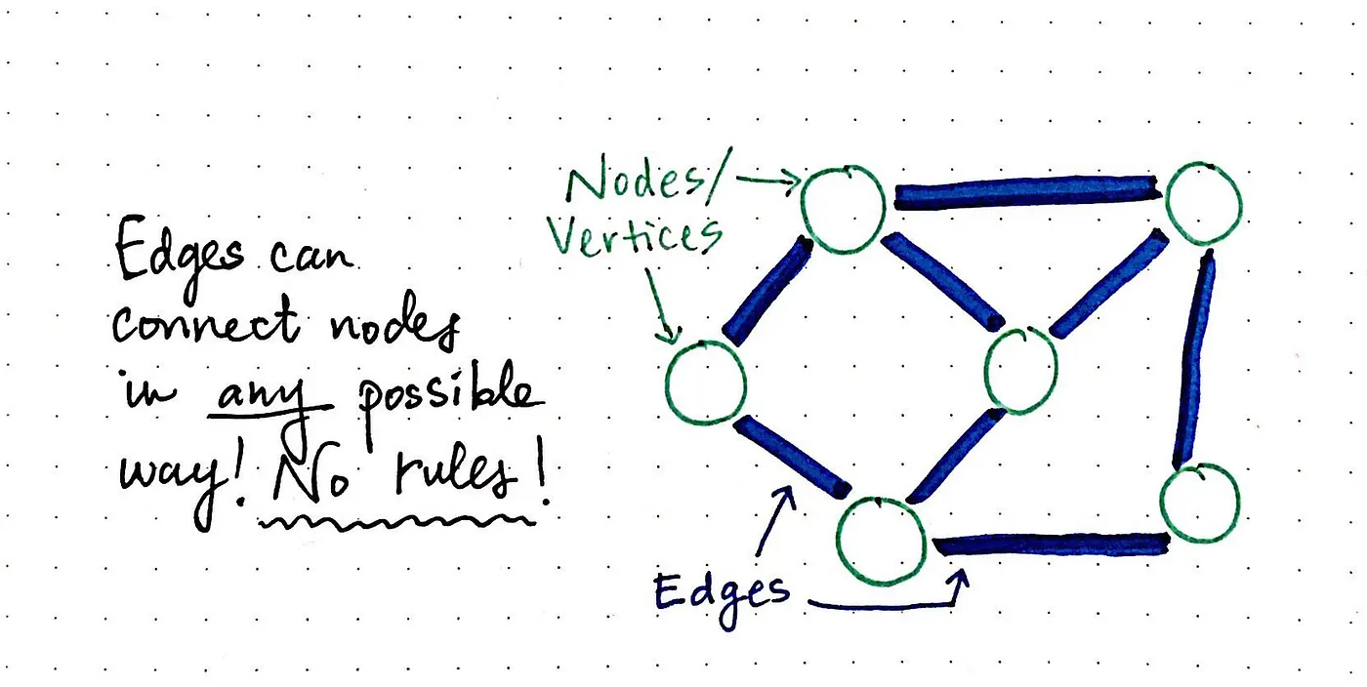
Components of a Graph

Slide 7
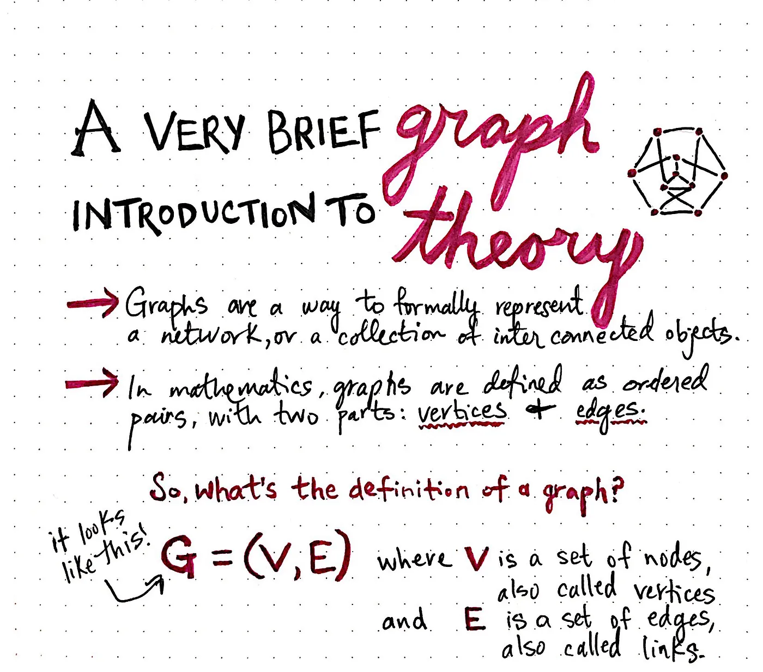

Slide 8
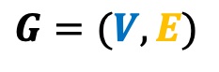
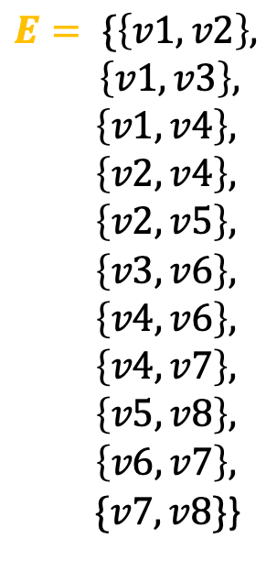
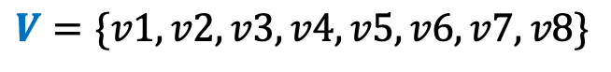
V1
V2
$$G=(V,E)$$
V3
V4
V5
$$V=\{v1, v2,v3,v4,v5,v6,v7,v8\}$$
$$E= \{\left\{v1, v2\right\},$$
$\left\{v1,v3\right\},$
$\left\{v1,v4\right\},$
$\left\{v2,v4\right\},$
$\left\{v2,v5\right\},$
$\left\{v3,v6\right\},$
$\left\{v4,v6\right\},$
$\left\{v4,v7\right\},$
$\left\{v5,v8\right\},$
$\left\{v6,v7\right\},$
$\{v7,v8\}$}
V6
V7
V8
8 vertices/nodes
11 edges

Slide 9
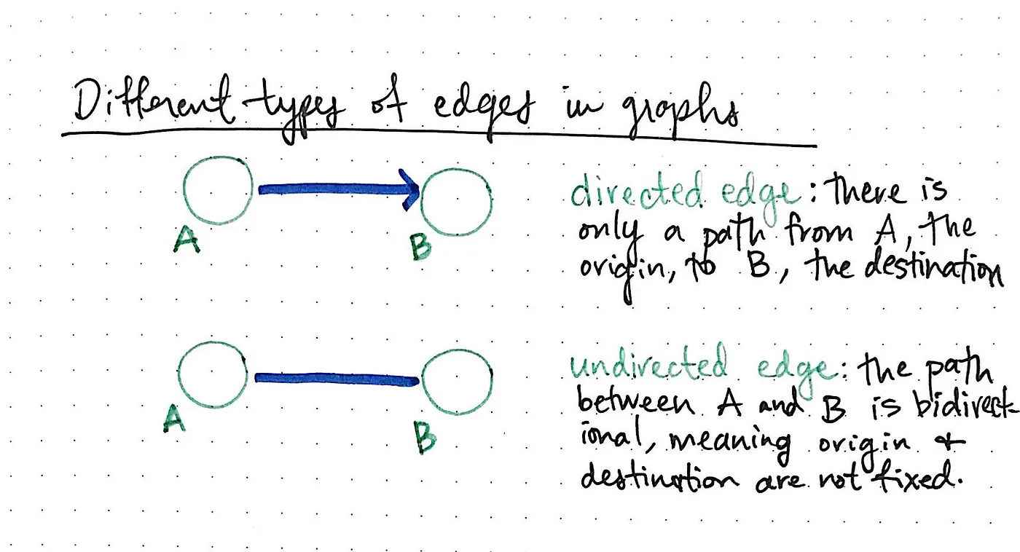

Slide 10
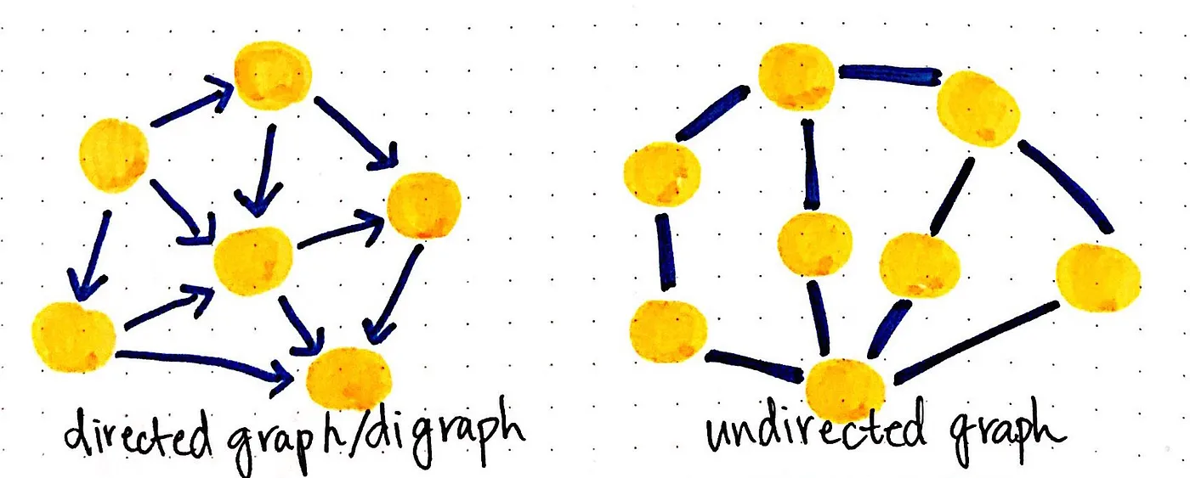

Slide 11
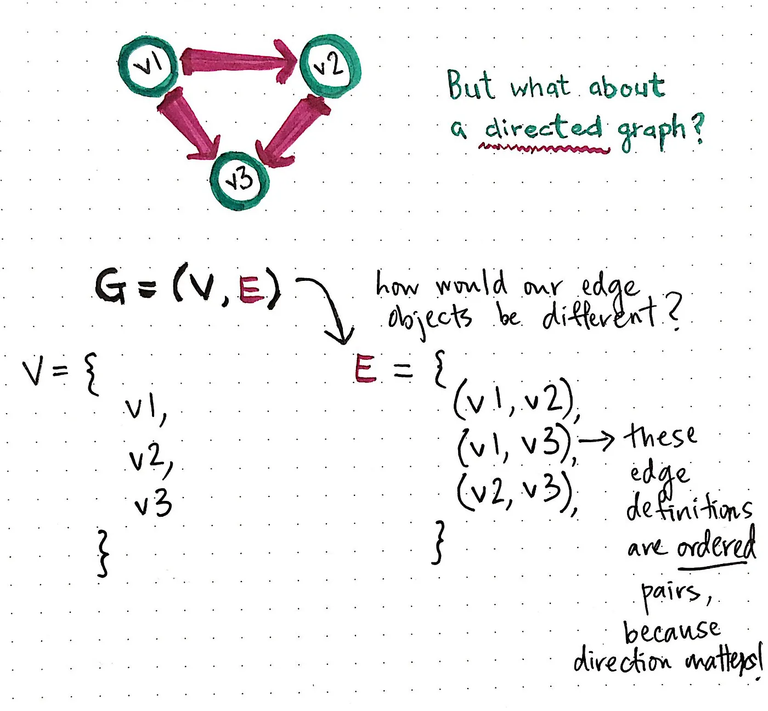

Slide 12
Terminologies
Adjacency
Path

Slide 13
Adjacency
A vertex is said to be adjacent to another vertex if there is an edge connecting them.

Slide 14




Adjacency
v1
v2
V1 is adjacent to V2, V3 and V4.
V3 is not adjacent to V2.
v3
v4

Slide 15
Path
A sequence of edges that allows you to go from vertex A to vertex B is called a path.

Slide 16
Path
V1
V2
Path from V4 to V2:
1. V4 to V1.
2. V1 to V2.
V3
V4

Slide 17
Graph Representation
Adjacency Matrix
Adjacency List

Slide 18
Adjacency Matrix
a two-dimensional array of V x V vertices. Each row and column represent a vertex.
a way of representing a graph as a matrix of Boolean (0’s and 1’s).

Slide 19
Adjacency Matrix
V1
V2
 |  | Nica | Jonnah | Ronn
 | 0 | 1 | 1 | 1
 | 1 | 0 | 1 | 0
 | 1 | 1 | 0 | 0
 | 1 | 0 | 0 | 0
V3
V4

Slide 20
Adjacency List
An adjacency list represents a graph as an array of linked lists.
The index of the array represents a vertex and each element in its linked list represents the other vertices that form an edge with the vertex.

Slide 21
Adjacency List
V1
V2
V3
V4

Slide 22


Connected Graph
A graph where every node can be visited from other nodes.

Slide 23
Disconnected Graph
A graph in which at least one node is not reachable from a node.

Slide 24
Complete Graph
A graph in which each node has edges to all other nodes

Slide 25
Weighted Graph
In a weighted graph, each edge is assigned with some value such as length or weight. The weight of an edge e must be a positive (+) value indicating the cost of traversing the edge.
10
5
3
8

Slide 26
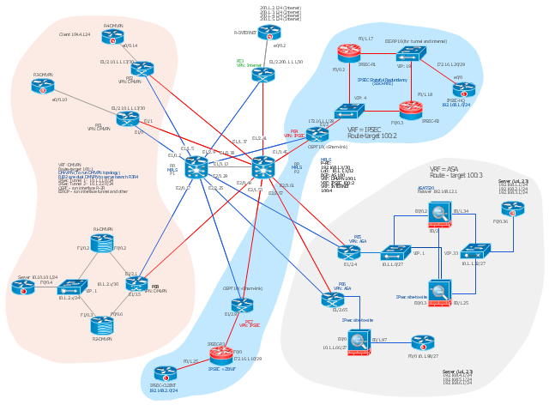
Network architecture and operations

Slide 27
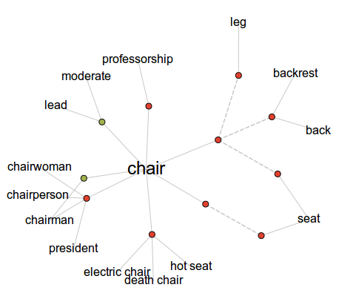
Word nets

Slide 28
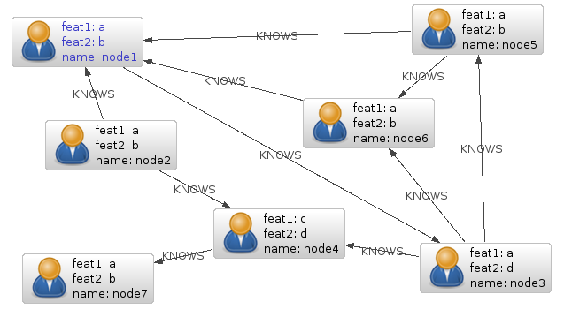
Relationships of database entities

Slide 29
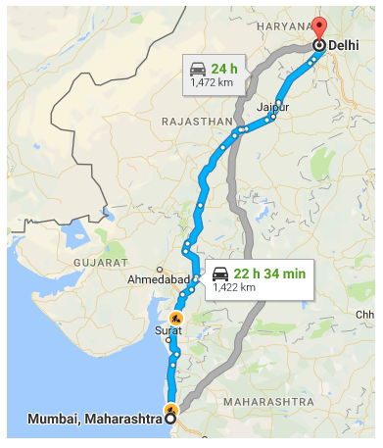
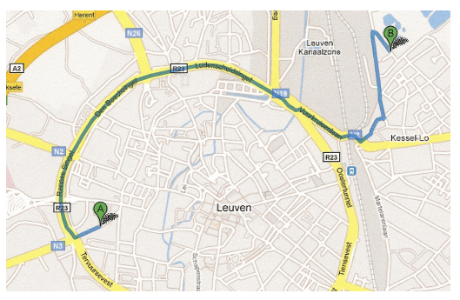
Navigation Systems

Slide 30
Graph Traversal

Slide 31
Graph Traversal
Graph search or traversal refers to the process of visiting or checking each vertex in a graph.
Many graph applications need to visit the vertices of a graph in some specific order based on the graph’s topology. This is known as a graph traversal and is similar in concept to a tree traversal.

Slide 32
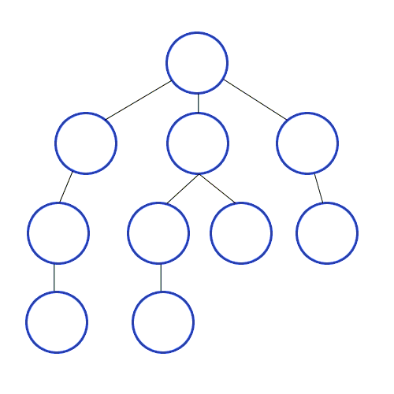
Graph Traversal
Breadth First Search
Depth First Search

Slide 33
Breadth First Search
Start by putting any one of the graph's vertices at the back of a queue.
Take the front item of the queue and add it to the visited list.
Create a list of that vertex's adjacent nodes. Add the ones which aren't in the visited list to the back of the queue.
Keep repeating steps 2 and 3 until the queue is empty.

Slide 34
Depth First Search
Start by putting any one of the graph's vertices on top of a stack.
Take the top item of the stack and add it to the visited list.
Create a list of that vertex's adjacent nodes. Add the ones which aren't in the visited list to the top of the stack.
Keep repeating steps 2 and 3 until the stack is empty.

Slide 35
Graph Traversal
Visiting a vertex.
Exploring a vertex.

Slide 36


Breadth First Search
Nica
J-Rhyzz
Jethro
Neal
Ronn
Tristan
Jonnah

Slide 37
Depth First Search
Nica
J-Rhyzz
Jethro
Neal
Ronn
Tristan
Jonnah

Slide 38
Breadth First Search
Neal
Ronn
Tristan
Jonnah
Nica
J-Rhyzz
Jethro

Slide 39
Depth First Search
Neal
Ronn
Tristan
Jonnah
Nica
J-Rhyzz
Jethro

Slide 40


Breadth First Search
Winna
Alexander
Nica
J-Rhyzz
Jethro
Kean
Jonnah
Ronn
Queue
Neal
Tristan

Slide 41
Depth First Search
Alexander
Winna
Nica
J-Rhyzz
Jethro
Kean
Jonnah
Ronn
Neal
Tristan

Slide 42
The Travelling Salesman Problem

Slide 43
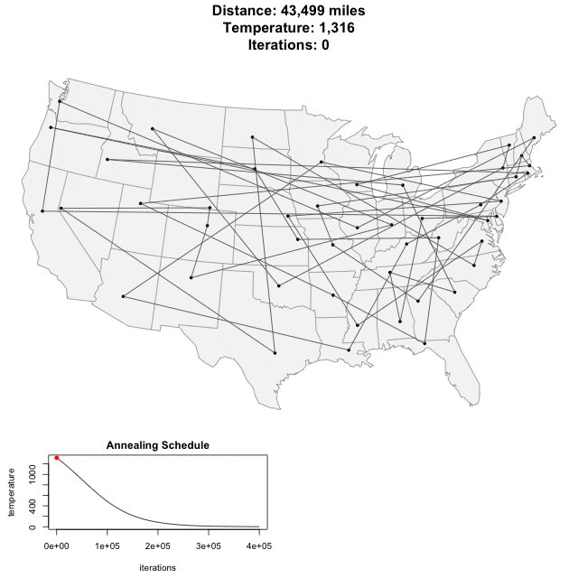
Introduction
The travelling salesman problem, also known as the travelling salesperson problem (TSP), asks the following question:
"Given a list of cities and the distances between each pair of cities, what is the shortest possible route that visits each city exactly once and returns to the origin city?"

Slide 44


Factorial Time Complexity
$$n!$$
Where n is the number of inputs
$$3!=3•2•1=6 computations$$
$$4!=4•3•2•1=24 computations$$
$$5!=5•4•3•2•1=120 computations$$
Notes:
There is a limitation in n factorial algorithms where there is not enough compute power to find the answer

Slide 45
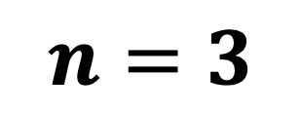
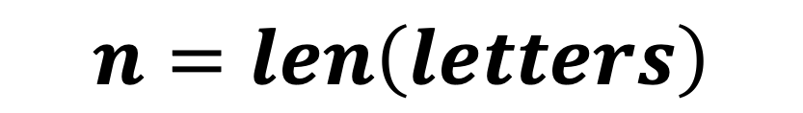
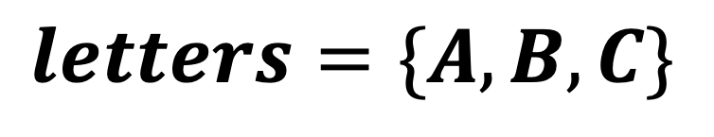
Example of n! (Permutations)
$$letters=\{A, B,C\}$$
$$n=len\left(letters\right)$$
$$n=3$$
Problem: Find all possible arrangements of the letters without omitting or repeating any letter

Slide 46
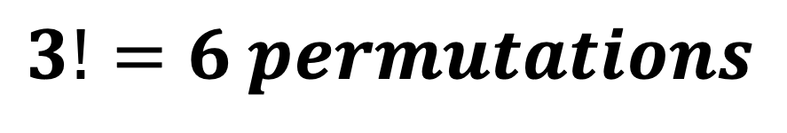
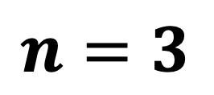
Permutations
$$n=3$$
A | B | C
A | C | B
B | A | C
B | C | A
C | A | B
C | B | A
$$3!=6 permutations$$
$$if we add one more letter, there would be 4!=24 permutations$$

Slide 47
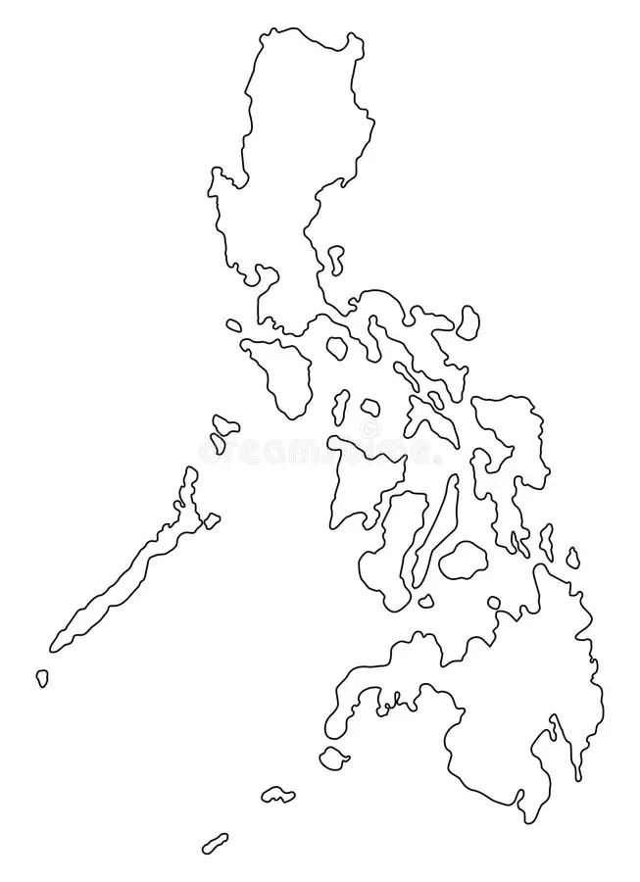
Manila
6
10
2
Tacloban
3
Puerto Princesa
7
2
Davao

Slide 48
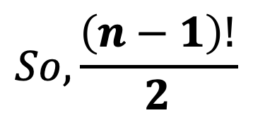
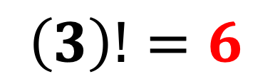
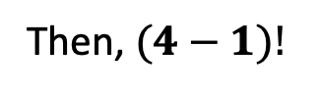
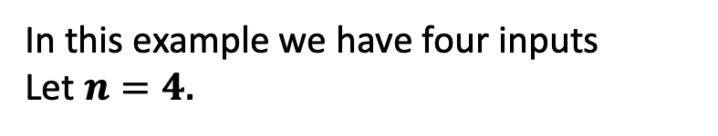
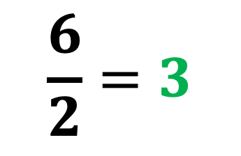
In this example we have four inputs
Let $n=4$.
Then, $(4−1)!$
Manila
$$\left(3\right)!=6$$
6
10
2
Actually, there are only 3 possible paths, the 3 other paths are only the reverse of the three possible paths!
Tacloban
3
Puerto Princesa
$$So, \frac{\left(n−1\right)!}{2}$$
7
2
$$\frac{6}{2}=3$$
Davao

Slide 49
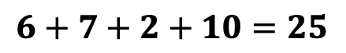
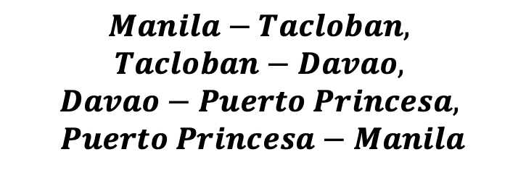
Manila
$$Manila−Tacloban,$$
$$Tacloban−Davao,$$
$$Davao−Puerto Princesa,$$
$$Puerto Princesa−Manila$$
6
10
Tacloban
Puerto Princesa
$$6+7+2+10=25$$
7
2
Davao

Slide 50
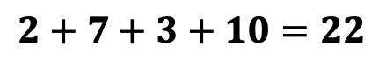

Manila
$$Manila−Davao,$$
$$Davao−Tacloban,$$
$$Tacloban− Puerto Princesa,$$
$$Puerto Princesa−Manila$$
10
2
Tacloban
3
Puerto Princesa
$$2+7+3+10=22$$
7
Davao

Slide 51
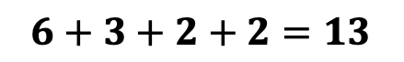
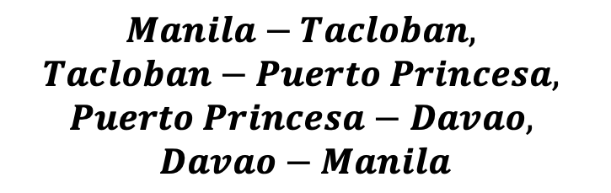
Manila
$$Manila−Tacloban,$$
$$Tacloban−Puerto Princesa,$$
$$Puerto Princesa−Davao,$$
$$Davao−Manila$$
6
2
Tacloban
3
Puerto Princesa
$$6+3+2+2=13$$
2
Davao

